Slide 1
ChatGPT Review
Member: Ritesh Penumatsa, Wai Kei Rachel Foong

Slide 2
Introduction
The datasets contain daily-updated user reviews and ratings for ChatGPT app in the past two years. The goal is to find out how the thumbs-up and sentence positivity level will affect the rating scores and the amount of users using the app.

Slide 3



Problem
Data
Method
Background and Motivation
Finding the best ML model for ChatGPT app rating scores predictions
Predict the impact of thumbs up and sentence positivity level on rating scores
ML Model using linear regression, ridge, lasso, decision tree and random forest

Slide 4
Our Hypothesis
If there is a correlation between the rating score, thumbs up count, and positive vs negative post.
We expect the greater the number of thumbs Up, the higher the rating score.
Positive post will receive a higher rating score than a neutral and negative post.

Slide 5
Variable
Named | Data Type | Remarks
UserName | Categorical, Nominal | The display name of the user who posted the review
Content | Categorical, Nominal | The text content of the review.
Score | Numerical, Ordinal | The rating given by the user, typically ranging from 1 to 5
thumbsUpCount | Numerical, Continuous | The number of thumbs up (likes) the review received.
At | Numerical, Continuous | The date and time when the review was posted

Slide 6
Data Preparation
Remove any irrelevant & NA values
Remove languages other than English
Eliminate duplicate values
Check for inconsistent formatting for dates, text, etc
Sample only 2000 from the data
Analyse pattern in data
Numerically and visually
Convert categorical data types into numerical ones (SentimentIntensityAnalyzer)

Slide 7

Demo

Slide 8
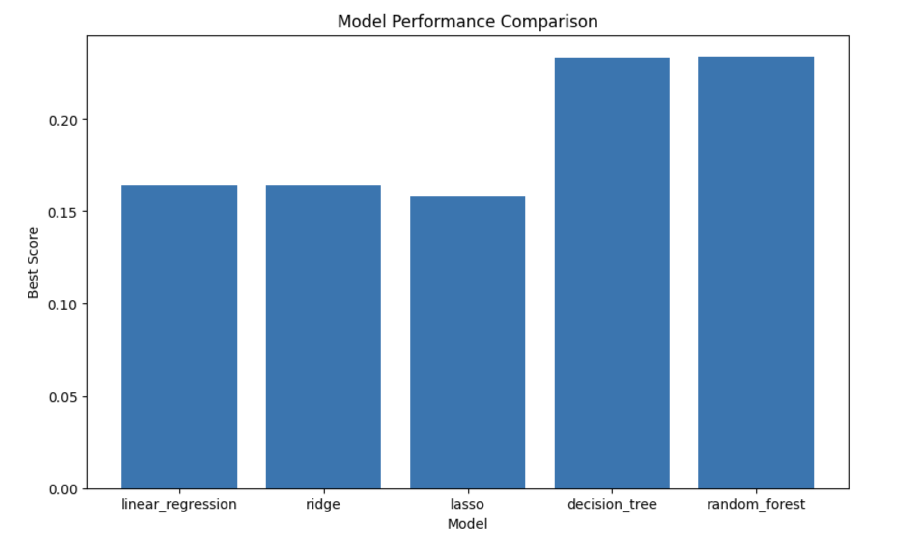
Model Performance Comparison

Slide 9
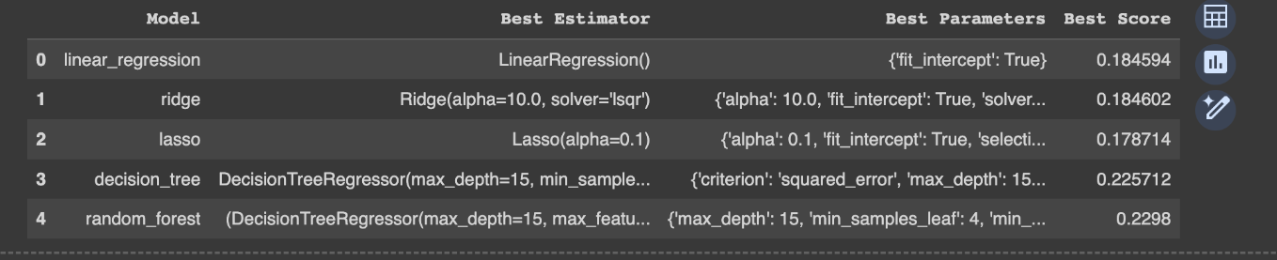
Regression Model Comparison

Slide 10
Selecting the Right Model
GridSearchCV
Regression Model: Random Forest
Training the Model
80% training data - 1600 samples
20% testing data - 400 samples

Slide 11
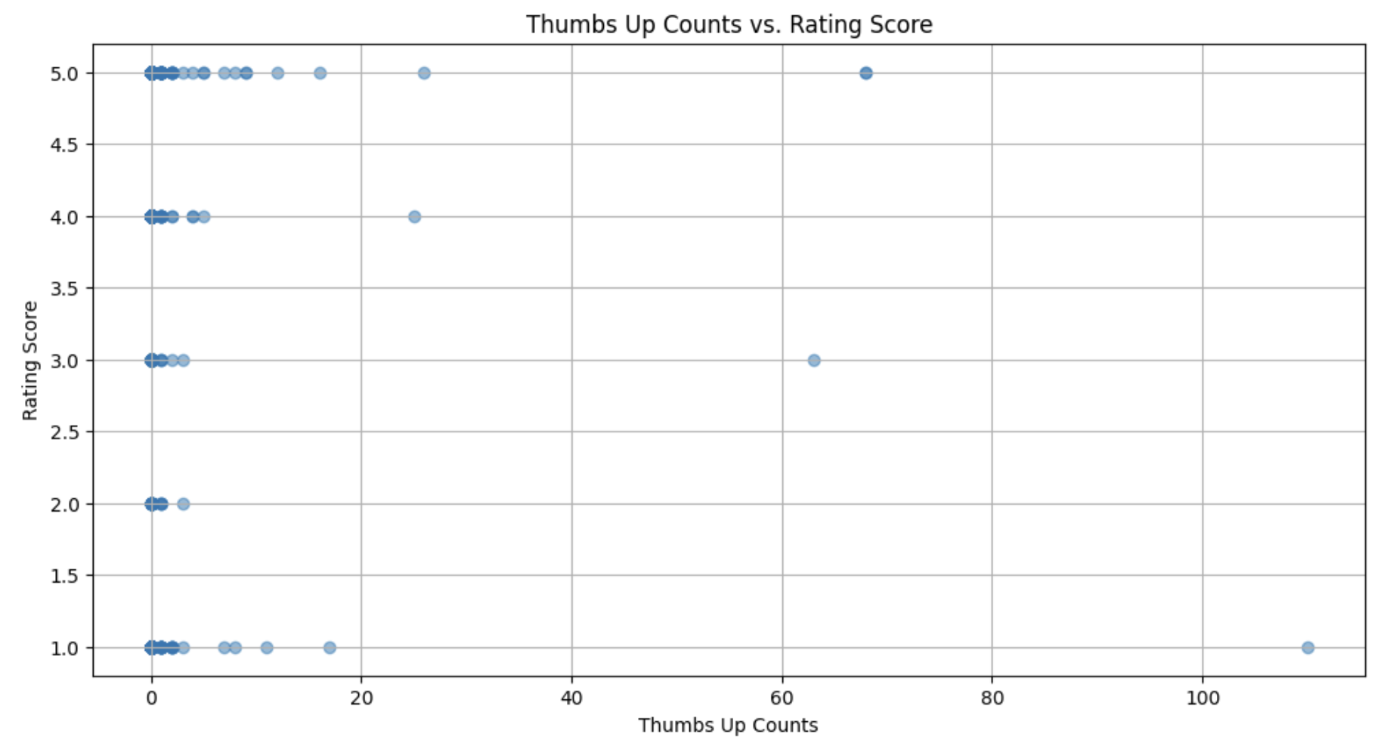
Finding and Results
Higher rating scores are more likely to receive a higher number of thumbs ups but the relationship is not significant.

Slide 12
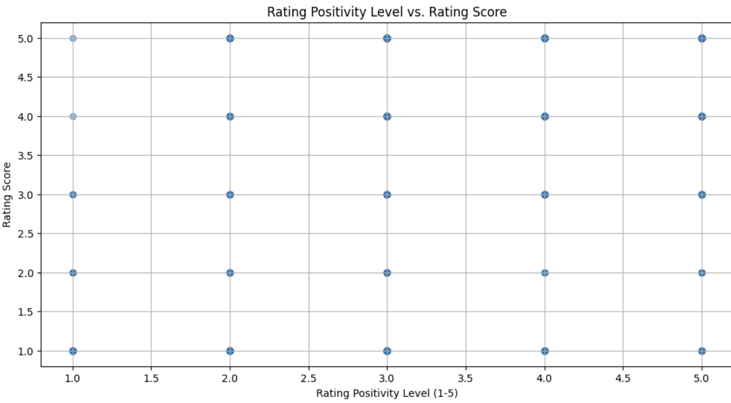
Finding and Results
No relationship between a positive vs negative post and their rating score

Slide 13
Model Prediction (rating score)
Thumbs Up Count | Content Score | Actual Rating Score | Predicted Rating Score
0 | 4 | 5 | ✅4.644 ~ 5
0 | 3 | 5 | ✅4.784 ~ 5
7 | 1 | 4 | ❌3.217 ~ 3
5 | 5 | 5 | ✅4.845 ~ 5

Slide 14

Results and Conclusion
Mean Squared Error: 1.22372
Mean Absolute Error: 0.78584
R-squared: 0.20696
The positivity level of the post has a slight impact on the rating score but not much to say it is an important factor
The number of thumbs ups of the post has no relation to the rating score

Slide 15
Error Analysis and Scope for Improvement
Our final model is a random forest model that has an accuracy of 0.35 on average.
The model accuracy is not as good as expected, but we simply want to analyse the pattern and predict the rating scores. The result may not be a strong indicator for ChatGPT peer reviews.
To improve our model, we might need to scale the features, and use more ensemble methods such as k-fold cross validation, L1 and L2 regularization, etc.

Slide 16
References and Documentation
Kaggle
Sentiment Analysis
Scikit Learn API
Improving Model Accuracy

Slide 17
Thank You!

